Slide 1

SOFTWARE ENGINEERING AND PROJECT MANAGEMENT (CSE 227)
Department of Computer Science and Engineering
School of Engineering,
PRESIDENCY UNIVERSITY

Slide 2
CHAPTER 2 Process Models
Department of Computer Science and Engineering
School of Engineering, Presidency University

Slide 3
Chapter 2 - Contents
What is Software Process?
SDLC – Software Development Life cycle
What is Software Process Model?
Generic Process Model
Identifying a Task Set within a Process Model
Prescriptive Models
Waterfall Model
V-Model
Incremental Model
Evolutionary Models - Prototyping and Spiral
Concurrent Model
Unified Process
Personal Software Process
Team Software Process

Slide 4
I. What is Software Process
Software Process (SP) is a framework for the activities, actions, and tasks that are required to build high-quality software.
SP defines the approach that is taken as software is engineered.
Is not equal to software engineering, which also encompasses technologies that populate the process - technical methods and automated tools.

Slide 5
II. Software Development Life Cycle(SDLC)
Software Development Life Cycle (SDLC) is a process used by the software industry to design, develop and test high quality software's.
The SDLC aims to produce a high-quality software that meets or exceeds customer expectations, reaches completion within times and cost estimates.
It is also called as Software Development Process.

Slide 6
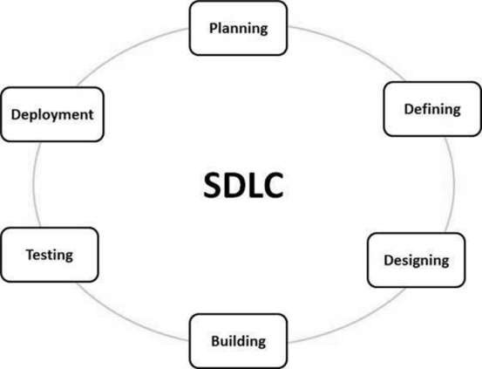
Software Development Life Cycle(SDLC)

Slide 7
LIFE CYCLE STAGES−
Stage 1: Planning and Requirement Analysis
Stage 2: Defining Requirements
Stage 3: Designing the Product Architecture
Stage 4: Building or Developing the Product
Stage 5: Testing the Product
Stage 6: Deployment in the Market and Maintenance

Slide 8
SDLC models followed in the industry
Waterfall Model
Iterative Model
Spiral Model
V-Model
Big Bang Model

Slide 9
III. What is Software Process Model
What: Go through a series of predictable steps - a road map that helps you create a timely, high-quality results.
Who: Software engineers and their managers, clients also. People adapt the process to their needs and follow it.
Why: Provides stability, control, and organization to an activity that can if left uncontrolled, become quite chaotic. However, modern software engineering approaches must be agile and demand ONLY those activities, controls and work products that are appropriate.

Slide 10
What is Software Process Model
What Work products: Programs, documents, and data
What are the steps: The process you adopt depends on the software that you are building. One process might be good for aircraft avionic system, while an entirely different process would be used for website creation.
How to ensure right: A number of software process assessment mechanisms that enable us to determine the maturity of the software process. However, the quality, timeliness and long-term viability of the software are the best indicators of the efficacy of the process you use.

Slide 11
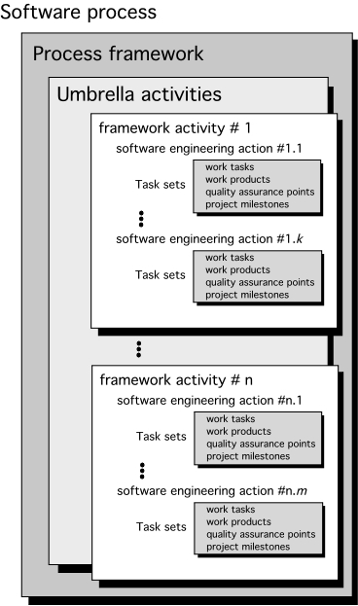
IV. Generic Process Model

Slide 12
Generic Process Model
A generic process framework for software engineering defines five framework activities - communication, planning, modeling, construction, and deployment.
In addition, a set of umbrella activities - project tracking and control, risk management, quality assurance, configuration management, technical reviews, and others are applied throughout the process.
Next question is: how the framework activities and the actions and tasks that occur within each activity are organized with respect to sequence and time? See the process flow for answer.

Slide 13
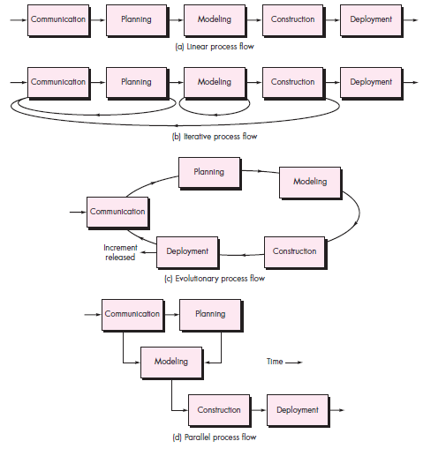
Process Flow in a Generic Process Model

Slide 14
Process Flow in a Generic Process Model
Linear process flow executes each of the five activities in sequence.
An iterative process flow repeats one or more of the activities before proceeding to the next.
An evolutionary process flow executes the activities in a circular manner. Each circuit leads to a more complete version of the software.
A parallel process flow executes one or more activities in parallel with other activities (Ex: modeling for one aspect of the software in parallel with construction of another aspect of the software).

Slide 15
V. Identifying a Task Set
Before you can proceed with the process model, a key question: what actions are appropriate for a framework activity given the nature of the problem, the characteristics of the people and the stakeholders?
A task set defines the actual work to be done to accomplish the objectives of a software engineering action.
A list of the task to be accomplished
A list of the work products to be produced
A list of the quality assurance filters to be applied

Slide 16
Identifying a Task Set – Example 1
For a small software project requested by one person with simple requirements, the communication activity might encompass little more than a phone call with the stakeholder. Therefore, the only necessary action is phone conversation, the task set for communication action includes:
1. Make contact with stakeholder via telephone.
2. Discuss requirements and take notes.
3. Organize notes into a brief written statement
of requirements.
4. E-mail to stakeholder for review and approval.

Slide 17
Identifying a Task Set – Example 2
The task sets for requirements elicitation action for a simple project may include:
Make a list of stakeholders for the project.
Invite all stakeholders to an informal meeting.
Ask each stakeholder to make a list of features and functions required.
Discuss requirements and build a final list.
Prioritize requirements.
Note areas of uncertainty.

Slide 18
Identifying a Task Set – Example 3
The task sets for requirements elicitation action for a BIG project may include:
Make a list of stakeholders for the project.
Interview each stakeholders separately to determine overall wants and needs.
Build a preliminary list of functions and features based on stakeholder input.
Schedule a series of facilitated application specification meetings.
Conduct meetings.
Produce informal user scenarios as part of each meeting.
Refine user scenarios based on stakeholder feedback.
Build a revised list of stakeholder requirements.
Use quality function deployment techniques to prioritize requirements.
Package requirements so that they can be delivered incrementally.
Note constraints and restrictions that will be placed on the system.
Discuss methods for validating the system.

Slide 19
VI. Prescriptive Models
Prescriptive models are used as guidelines to organize and structure how software developmental activities should be performed, and in what order.
The name 'prescriptive' is given because the model prescribes a set of activities, actions, tasks, quality assurance and change the mechanism for every project.

Slide 20
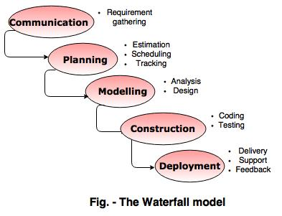
6.1. Waterfall Model

Slide 21
6.1. Waterfall Model
The waterfall model is also called as 'Linear sequential model'.
In this model, each phase is fully completed before the beginning of the next phase.
This model is used for small projects.
Assumes that requirements are defined and reasonably stable.
Testing part starts only after the development is complete.

Slide 22
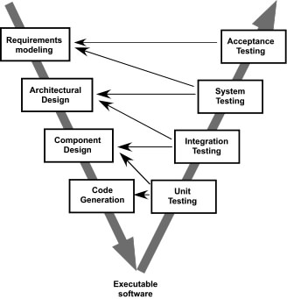
6.2. The V-Model

Slide 23
6.2. The V-Model
A variation of waterfall model depicts the relationship of quality assurance actions to the actions associated with communication, modeling and early code construction activates.
Team first moves down the left side of the V to refine the problem requirements. Once code is generated, the team moves up the right side of the V, performing a series of tests that validate each of the models created as the team moved down the left side.

Slide 24
6.3. The Incremental Model

Slide 25
6.3. The Incremental Model
When initial requirements are reasonably well defined, but the overall scope of the development effort precludes a purely linear process. A compelling need to expand a limited set of new functions to a later system release.
It combines elements of linear and parallel process flows. Each linear sequence produces deliverable increments of the software.
The first increment is often a core product with many supplementary features. Users use it and evaluate it with more modifications to better meet the needs.

Slide 26
6.4. Evolutionary Models
Software system evolves over time as requirements often change as development proceeds.
Usually a set of core product or system requirements is well understood, but the details and extension have yet to be defined.
You need a process model that has been explicitly designed to accommodate a product that evolved over time.
It is iterative that enables you to develop increasingly more complete version of the software.
Types: Prototyping and Spiral models.

Slide 27
6.4a. Evolutionary Models - Prototyping
When to use: Customer defines a set of general objectives but does not identify detailed requirements for functions and features. Or Developer may be unsure of the efficiency of an algorithm, the form that human computer interaction should take.
Advantages: Both stakeholders and software engineers like the prototyping paradigm. Users get a feel for the actual system, and developers get to build something immediately. However, engineers may make compromises in order to get a prototype working quickly. The less-than-ideal choice may be adopted forever after you get used to it.

Slide 28
6.4a. Evolutionary Models - Prototyping
Quick
plan
communication
Modeling
Quick design
Deployment
delivery &
feedback
Construction
of prototype

Slide 29
6.4b. Evolutionary Models - Spiral
It couples the iterative nature of prototyping with the controlled and systematic aspects of the waterfall model and is a risk-driven process model generator that is used to guide multi-stakeholder concurrent engineering of software intensive systems.
Two main distinguishing features: one is cyclic approach for incrementally growing a system’s degree of definition and implementation while decreasing its degree of risk. The other is a set of anchor point milestones for ensuring stakeholder commitment to feasible and mutually satisfactory system solutions.

Slide 30
6.4b. Evolutionary Models - Spiral

Slide 31
Three Concerns of Evolutionary Models
First concern is that prototyping poses a problem to project planning because of the uncertain number of cycles required to construct the product.
Second, it does not establish the maximum speed of the evolution. If the evolution occur too fast, without a period of relaxation, it is certain that the process will fall into chaos. On the other hand if the speed is too slow then productivity could be affected.
Third, software processes should be focused on flexibility and extensibility rather than on high quality. We should prioritize the speed of the development over zero defects. Extending the development in order to reach high quality could result in a late delivery of the product when the opportunity niche has disappeared.

Slide 32
6.5. Concurrent Model
Allow a software team to represent iterative and concurrent elements of any of the process models. For example, the modeling activity defined for the spiral model is accomplished by invoking one or more of the following actions: prototyping, analysis and design.
Concurrent modeling is applicable to all types of software development and provides an accurate picture of the current state of a project. Rather than confining software engineering activities, actions and tasks to a sequence of events, it defines a process network. Each activity, action or task on the network exists simultaneously with other activities, actions or tasks. Events generated at one point trigger transitions among the states.

Slide 33
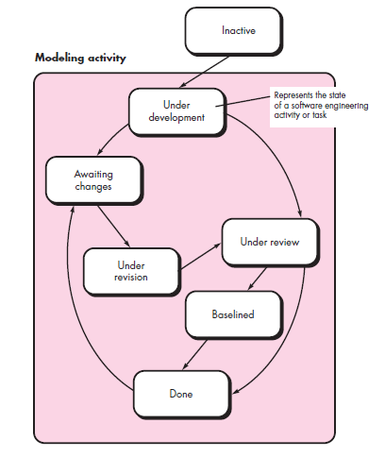
6.5. Concurrent Model

Slide 34
Other Process Models…
Component based development - the process to apply when reuse is a development objective ( like spiral model)
Formal methods - emphasizes the mathematical specification of requirements ( easy to discover and eliminate ambiguity, incompleteness and inconsistency)
Aspect Oriented software development (AOSD) - provides a process and methodological approach for defining, specifying, designing, and constructing aspects
Unified Process - a “use-case driven, architecture-centric, iterative and incremental” software process closely aligned with the Unified Modeling Language (UML) to model and develop object-oriented system iteratively and incrementally.

Slide 35
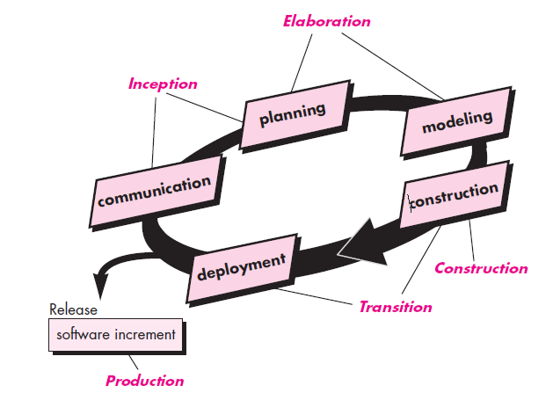
7. The Unified Process (UP)

Slide 36
UP Phases

Slide 37
UP Work Products

Slide 38
8. Personal Software Process (PSP)
The Personal Software Process (PSP) is a structured software development process that is intended (planned) to help software engineers better understand and improve their performance by tracking their predicted and actual development of code.
PSP helps software engineers to:
Improve their estimating and planning skills.
Make commitments they can keep.
Manage the quality of their projects.
Reduce the number of defects in their work.
Develop metrics for all project related activities, i.e., code, test etc.

Slide 39
9. Team Software Process (TSP)
Is Intended to improve the levels of quality and productivity of a team's software development project
Build self-directed teams that plan and track their work, establish goals, and own their processes and plans. These can be pure software teams or integrated product teams (IPT) of three to about 20 engineers.
Show managers how to coach and motivate their teams and how to help them sustain peak performance.
Accelerate software process improvement by making CMM Level 5 behavior normal and expected.
Provide improvement guidance to high-maturity organizations.

Slide 40
Criteria for selecting the right process model
Factors | Waterfall | V-Shaped | Evolutionary Prototyping | Spiral | Iterative and Incremental | Agile
Unclear User Requirement | Poor | Poor | Good | Excellent | Good | Excellent
Unfamiliar Technology | Poor | Poor | Excellent | Excellent | Good | Poor
Complex System | Good | Good | Excellent | Excellent | Good | Poor
Reliable system | Good | Good | Poor | Excellent | Good | Good
Short Time Schedule | Poor | Poor | Good | Poor | Excellent | Excellent
Strong Project Management | Excellent | Excellent | Excellent | Excellent | Excellent | Excellent
Cost limitation | Poor | Poor | Poor | Poor | Excellent | Excellent
Visibility of Stakeholders | Good | Good | Excellent | Excellent | Good | Excellent
Skills limitation | Good | Good | Poor | Poor | Good | Poor
Documentation | Excellent | Excellent | Good | Good | Excellent | Poor
Component reusability | Excellent | Excellent | Poor | Poor | Excellent | Poor

Slide 41
CASE STUDIES…
Case 1: Company X has purchased a CRM (Customer Relationship Management) solution to handle its FMCG (Fast Moving Consumer Goods) operations. The CRM solution is deployed within Company X, but needs to be customized according to its needs. The customized requirements are defined thoroughly by the company management. What process model is right for this requirement?
Best fit model – Waterfall model.
Rationale: Since the requirements for the customization of the CRM solutions is well defined, the complexity and risk of project execution is low, hence waterfall model is a good fit solution.

Slide 42
CASE STUDIES…
Case 2: A banking customer needs a website to be developed. The basic set of features are well defined, however, the advanced features are thought to be evolving in nature. The basic feature set includes development of retail portal for customer login, checking of account status and account balance. Advanced features include: account transfer, change of customer pin etc. What process model is right for this requirement?
Best fit model: Incremental model
Rationale: All the basic features of the website can be developed and deployed as Iteration 1, so that customers can start using the website. Subsequent evolving requirements can be handled in other iteration phases, as and when the features are freezed.

Slide 43
CASE STUDIES…
Case 3: A Company Y which is a manufacturer of medical equipments’ wants to model a three-dimensional visualization of anatomical part, which improves the quality of preoperative planning and assists in the selection of optimal surgical approach for prosthetic implants. What process model is right for this requirement?
Best fit model: Evolutionary Model - Prototyping
Rationale: A 3D prototype of any anatomical part can be developed based on the requirements and examined. Once the 3D prototype is approved, the system can be developed to incorporate other anatomical parts.

